Slide 1
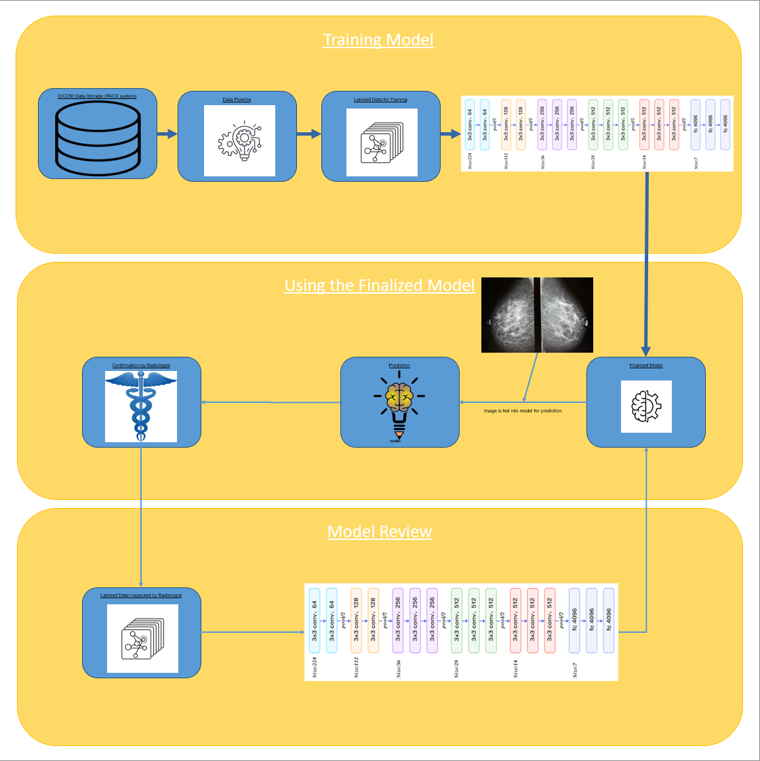
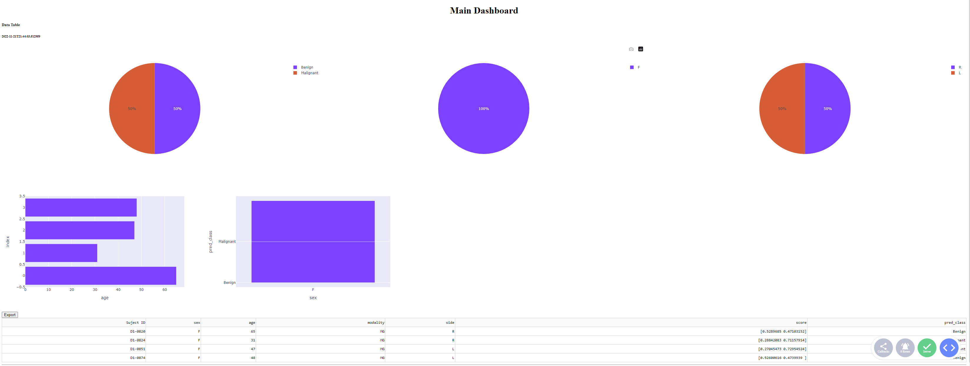
Advisor Name:
Grand Canyon University
The Utilization of Artificial Intelligence to Diagnose Tumors
Wilson B. Peguero Rosario
Context & Background
Use deep learning algorithms to classify DICOM images of possible tumors as benign or malignant
Initial application will be based on retrospective mammograms.
Metadata available will be used to assist the algorithm.
Research Question
Can machine learning algorithms be used to mitigate the demand for radiologists?
Machine Learning Model Flow Chart
Implications
Patient Benefits
Faster Diagnosis
Decrease in misdiagnosis
Overall Benefits
Versatility in Diagnosis (able to diagnose using any modality/ medical history)
Future version may pinpoint tumor for surgical extraction
Materials and Methods
TensorFlow Platform
Dash library for building Dashboards
DICOM data set from TCIA
Preview of the Dashboard
Reference
Can Artificial Intelligence Help See Cancer in New Ways? – NCI
The Role of Artificial Intelligence in Early Cancer Diagnosis - PMC (nih.gov)
We would like to acknowledge ....

Slide 2



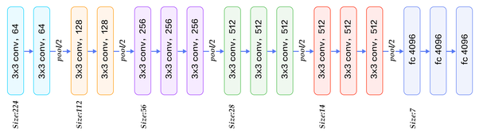
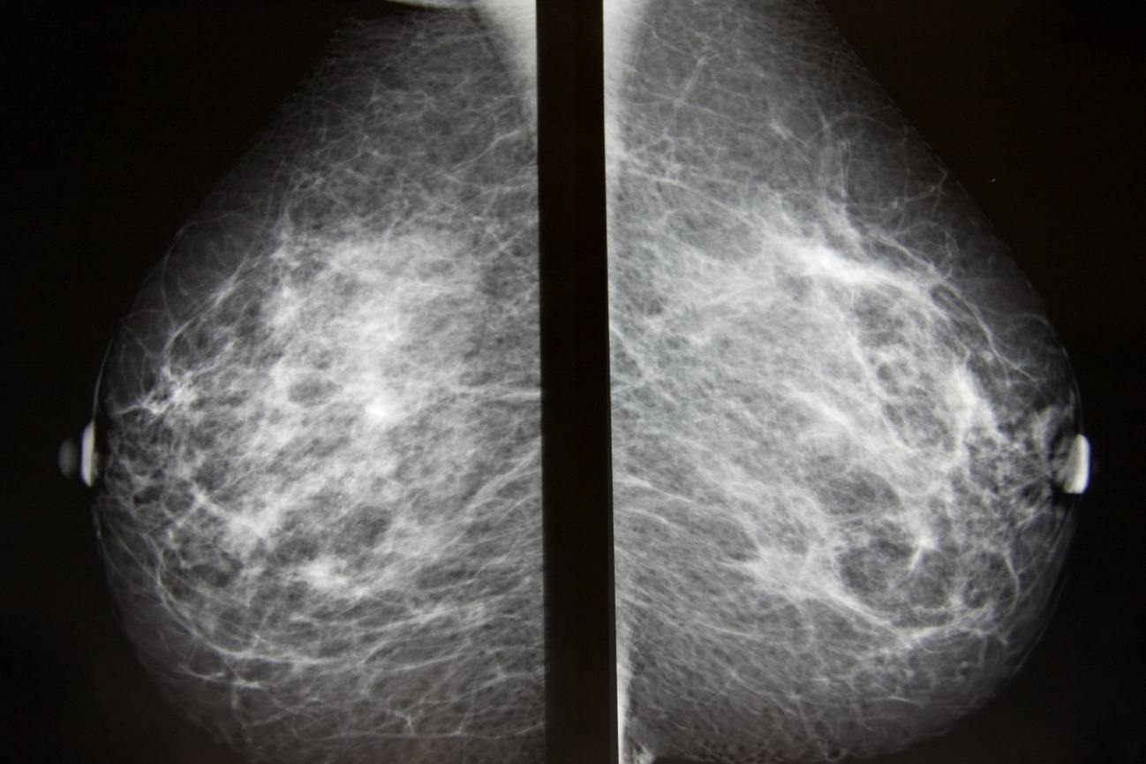



Training Model
DICOM Data Storage (PACS system)
Data Pipeline
Labeled Data for Training
Using the Finalized Model
Confirmation by Radiologist
Prediction
Finalized Model
Image is fed into model for prediction.
Model Review
Labeled Data Inspected by Radiologist

